Slide 1

By Benson Chen
First Step to Money-Making
Mobile Games
-No bullshit Guide-

Slide 2
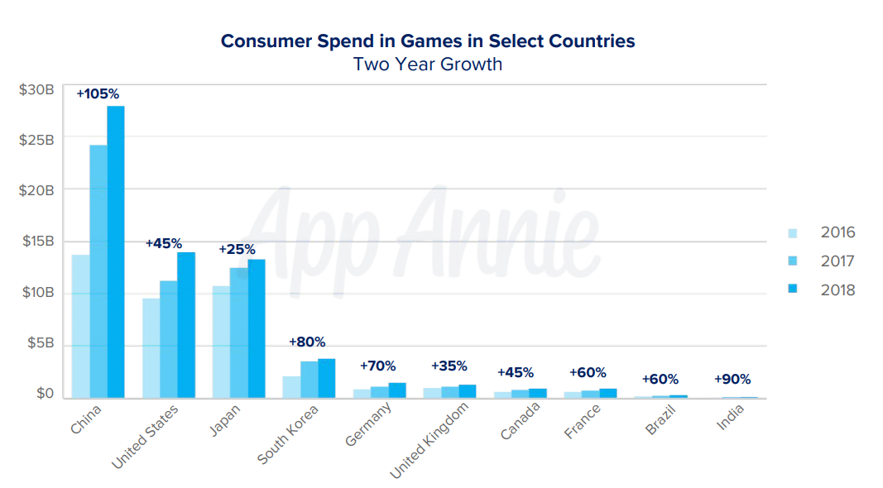
Mobile Game Market is on the Rise
Reported by mobile market research firm App Annie

Slide 3
Today’s focus: advices for mobile game makers.
Who are you?
Mobile game company
Game developer
Someone just finished boot camp and want to make a game
Just a stranger
My goal today?
Recommendations on features you should include on your next mobile game.

Slide 4

The Process
01
Assumption: Top ranking games have common features
02
Scrape game overview data from
sensortower.com
Assumption
Data Collection
Features selection
03
Determines which features may have impact on revenue
Regression Model
Finding and Recommendation
04
Build regression models, train, cross-validate, and test. Find the best fit model.
05
Finding and Recommendation on mobile games

Slide 5
Assumptions:
successful mobile games share certain features. Decisions on whether adopt those feature in early gaming development phase is critical.

Slide 6
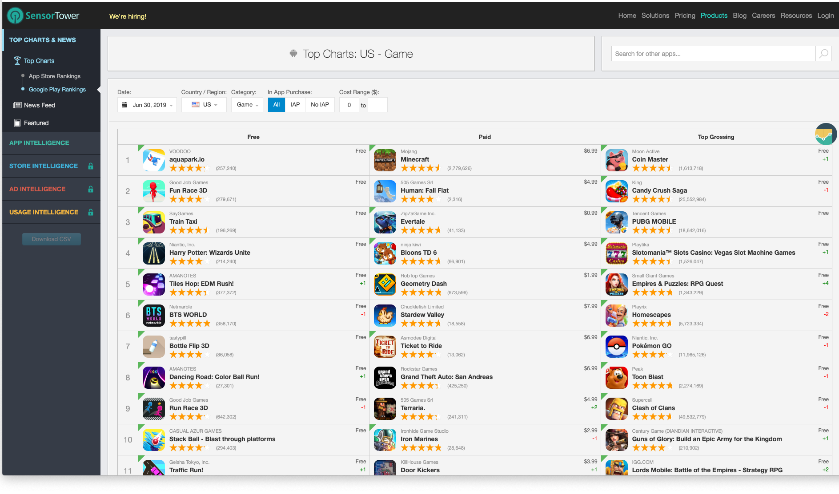
Data Collection
Web Scraping

Slide 7

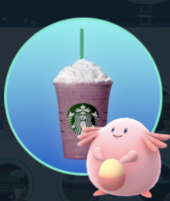
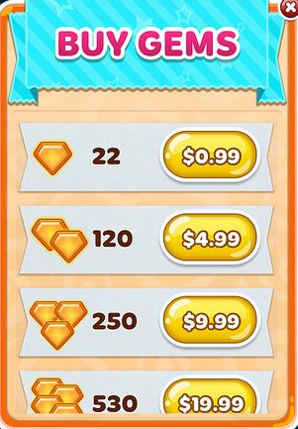
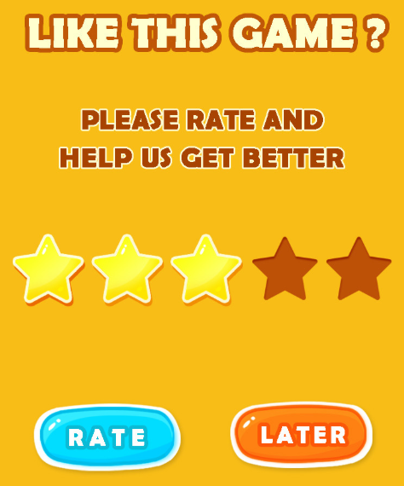
Feature Selection: does it affect revenue?
Free/Pay to play?
In game ads?
In game purchase?
High rating?

Slide 8


Samples after data cleaning
 | June Revenue | June Downloads | Overall Rating
counts | 3,110 | 3,110 | 3,110
mean | $704,568 | 633,424 | 4.37
std | $2,535,866 | 1,921,512 | 0.41
min | $5,000 | 5,000 | 1.00
25% | $5,000 | 5,000 | 4.24
50% | $20,000 | 70,000 | 4.50
75% | $300,000 | 400,000 | 4.52
max | $34,000,000 | 27,000,000 | 5.00
Sample Size: 808
Unique games
Sample Size: 729
Unique games
723 Same Games in both platform
Total sample size = 2,983

Slide 9
Non-linear Data
June Revenue
10m Club:
36 (1.2%)
publisher name | Game name | OS | revenue
NetEase Games | 梦幻西游 | iOS | $ 34,000,000
GARENA | Garena Free Fire | android | $ 31,000,000
King | Candy Crush Saga | ios | $ 29,000,000
Supercell | Clash of Clans | ios | $ 28,000,000
King | Candy Crush Saga | android | $ 26,000,000
Supercell | Clash of Clans | android | $ 25,000,000
Niantic, Inc. | Pokemon GO | android | $ 23,000,000
Roblox Corporation | Roblox | ios | $ 23,000,000
Playrix | Homescapes | ios | $ 22,000,000
Tencent Games | PUBG MOBILE | android | $ 21,000,000
Moon Active | Coin Master | android | $ 20,000,000
Niantic, Inc. | Pokemon GO | ios | $ 20,000,000
NetEase Games | Knives Out | ios | $ 20,000,000
1m Club:
310 (10.4%)
100K Club: 683
(22.9%)
5k-100K: 907 (30.4%)
73%
5k Club:1047 (35%)
43%

Slide 10
Regression Model
Simple Regression
R^2 = 0.32
Log(revenue Y)
1) To due with the exponential growth of revenue.
2)Reduces heteroscedasticity (i.e., stabilizes variance)
3) Applying log make y looks more normal
0.32
Simple OLS Regression
Bad R^2 due to right skewed target, high and unstable variance.
0.51
Features Engineering
1) Log(rating counts)
2) Log(downloads)
Model info:
Target: Revenue -> log(Revenue)
Features:
Free or Pay to play
Contain in game ads
iOS or Android
In game purchase
Rating and Rating Counts
Categories
Downloads
0.54
Run Cross Validation and Regularization
- Ridge Regression stand out with R^2 of 0.54
Test the Model
Ridge Regression
R^2 = 0.53

Slide 11
Recommendations
Android(1)
/ios(0)?
ios
Coeff: -0.14
Rating
counts?
Coeff: -0.42
No In-game ads, but have purchase
Counts wanted
Free/Pay?
Coeff: 0.87
Overall Rating?
Free
In-game Ads?
Four star is the sweet spot
Coeff: -0.90
Role Playing : 0.68
Casino:
0.51
Simulation: 0.47
Coeff: 2.15
categories

Slide 12
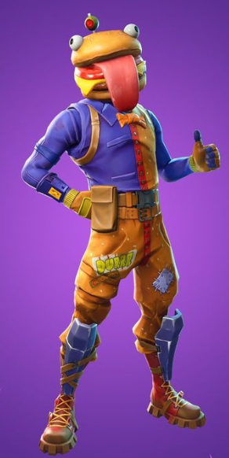
Good Game

